Slide 1
Studying Effects of Meltdown and Spectre Patches on the Performance of HPC Applications Using Application Kernel Module of XDMoD
Nikolay A. Simakov, Martins D. Innus, Matthew D. Jones, Ohad Katz, Joseph P. White, Ryan Rathsam, Steven M. Gallo, Robert L. DeLeon and Thomas R. Furlani
November 11, 2018, HPCSYSPROS18 at SC18

Slide 2
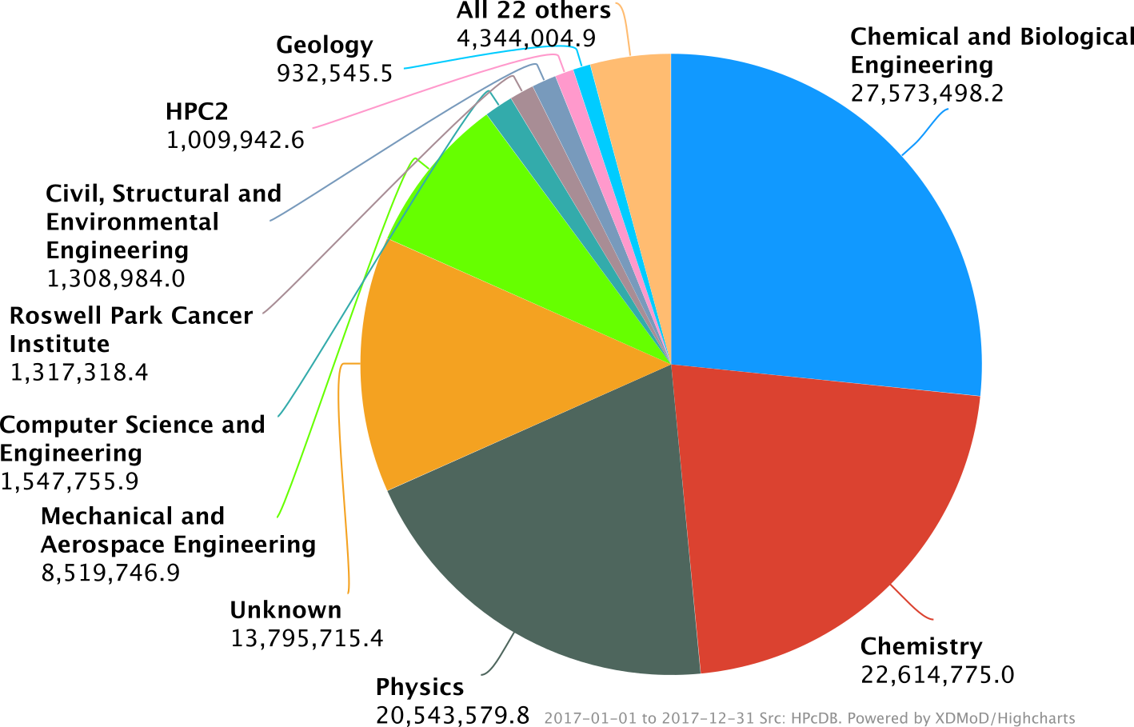
Center for Computational Research, University at Buffalo
Regional HPC Center
Serving academic and industry users from Western NY
11,408 Cores (798 Nodes) Academic Cluster
3,456 Cores (216 Nodes) Industry Cluster
500 active users and 200 PI
104 millions cores hours delivered in 2017
Develop XDMoD, a tool for HPC resources usage and performance monitoring

Slide 3
Application Kernel Performance Monitoring Module of XDMoD
Application kernels:
Based on benchmarks or applications
Computationally lightweight (Short runtime)
Run repeatedly on high performance computing (HPC) clusters in order to track the Quality of Service (QoS) provided to the users.
They have been successful in detecting a variety of hardware and software issues, some severe, that have subsequently been corrected, resulting in improved system performance

Slide 4
Meltdown and Spectre Vulnerabilities
Vulne-rability | Description | Remedy
Meltdown | Rogue Data Cache Load Exploit uses speculative cache loading to allow a local attacker to be able to read the contents of memory | Kernel patches: Kernel Page Table Isolation
Spectre, Variant 1 | Bounds Check Bypass Bounds-checking exploit during branching | Kernel patches
Spectre, Variant 2 | Branch Target Injection Indirect branching poisoning attack that can lead to data leakage. | Microcode update and kernel patches
https://meltdownattack.com/
https://access.redhat.com/security/vulnerabilities/speculativeexecution
https://access.redhat.com/articles/3311301

Slide 5
Application Kernels
Application | Description
NWChem | Computational chemistry code with wide range of methods from molecular mechanics and molecular dynamics to full ab initio calculations.
GAMESS‐US | An ab initio computational chemistry code
NAMD | A parallel molecular dynamics code that was specifically designed for high performance simulations on large HPC clusters
Enzo | Adaptive mesh refinement code for astrophysical simulation of cosmological structure formation
Graph500 | A benchmark that measures the performance of breadth‐first search on a graph
HPCC | Collection of seven tests: (1) Linpack; (2) matrix multiplication; (3) memory bandwidth; (4) parallel matrix transpose; (5) random memory access; (6) fast Fourier transform; and (7) bandwidth and latency
IMB | Benchmarking MPI routings
IOR | Parallel file systems benchmark using portable operating system interface (POSIX), MPI‐IO, and hierarchical data format 5 (HDF5) interfaces.
MDTest | Metadata file system operation benchmark

Slide 6
Test System and Used Updates
Test cluster
Few nodes separated from production cluster, for developmental purposes
Eight-core nodes with two Intel L5520 CPUs and 24GiB RAM
Connected by QDR Mellanox Infiniband
Parallel filesystem: 3 PB IBM GPFS storage system shared with other HPC resources in CCR.
CentOS Linux - 7.4.1708.
A new kernel and linux-firmware were installed to address the Meltdown and Spectre vulnerabilities
kernel-3.10.0-693.5.2 was updated to kernel-3.10.0-693.11.6
This is January, 2018 fixes

Slide 7
Results. Performance Impact. Execution Time
App.Kernel | Difference, %
 | 1 Node | 2 Nodes
NAMD | 3.3 | 6.9
NWChem | 2.6 | 11.4
HPCC | 2.2 | 5.3
IMB |  | 4.1
IOR | 3.7 | 0.7
IOR.local | 2.0
MDTest | 22.9 | 9.1
MDTest.local | 68.0

Slide 8
Results. Performance Impact. Selected Metrics
App. Kernel | Nodes | Metrics | Difference, % | Units
NAMD | 2 | Molecular Dynamics Simulation Performance | -6.6 | Second per Day
HPCC | 2 | High Performance LINPACK Floating-Point Performance | -8.6 | MFLOP per Second
 |  | Fast Fourier Transform (FFTW) Floating-Point Performance | -6.4 | MFLOP per Second
 |  | Parallel Matrix Transpose (PTRANS) | -9.6 | MByte per Second
MDTest | 1 | Directory creation (single tree directory) | -15.1 | Operations/Second
 |  | Directory removal (single tree directory) | -16 | Operations/Second
 |  | Directory stat (single tree directory) | -18.4 | Operations/Second

Slide 10
Parallel Performance Impact
Analyzed performance metrics from continuous performance monitoring on production CCR UB-HPC cluster
NAMD, NWChem and ENZO do exhibit a significant degradation of their performance as the number of nodes increases.

Slide 11
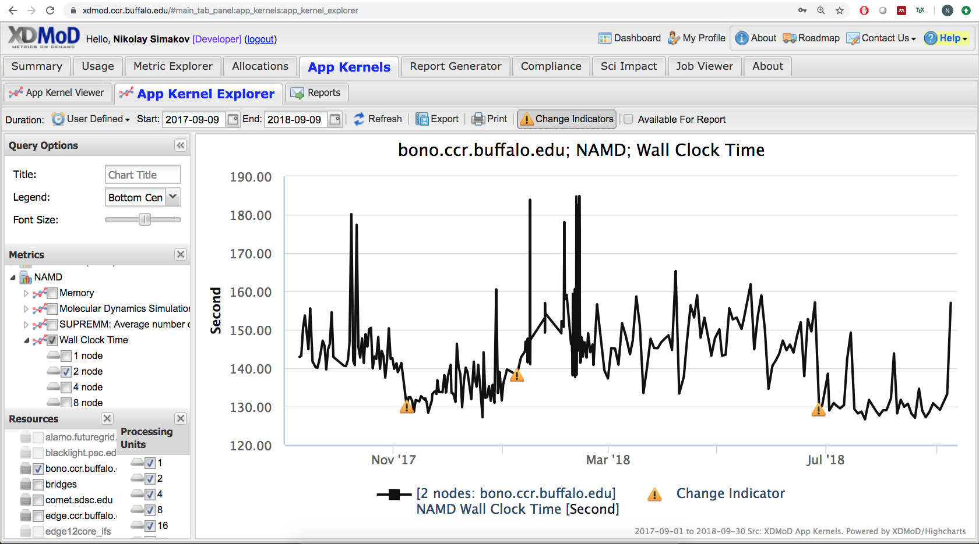
Metdown Spectre Initial Remedy
Update to Centos 7.4
Metdown Spectre Second Gen. Remedy

Slide 12
Conclusions
In addition to continuous HPC system performance monitoring for quality of service, the application kernel module of XDMoD also allows rapid benchmarking of HPC systems to identify the impact of a particular change on the system.
We are planning to improve application kernel performance monitoring module of XDMoD interface to facilitate such benchmarking
The original security patches have a significant degrading effect on multiple metrics, most notably MPI calls and file metadata operations. Many other metrics show little to no change.
Overall, scientific applications executed on a single node have a moderate decrease in the performance around 2-4%.
However, the performance degradation grows with node count reaching 27% in one case. This most likely is caused by increasing the number of network related system calls.
Newer fixes significantly reduces the performance impact.

Slide 13
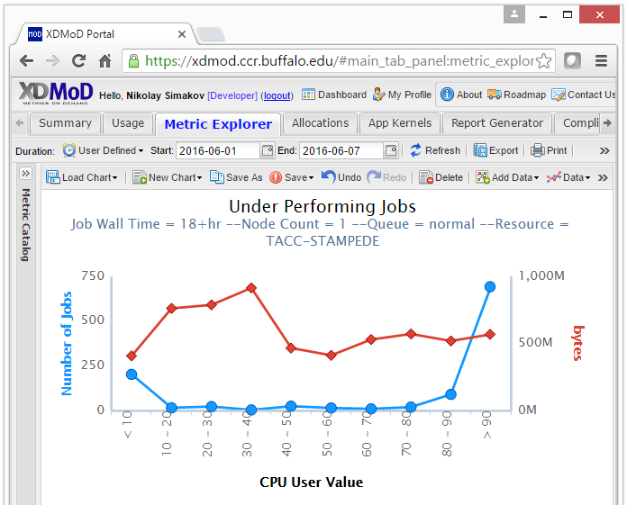
Questions?
A Tool for HPC resources usage and performance analysis - http://open.xdmod.org/
Provide resources utilization and performance monitoring services for XSEDE systems - http://xdmod.ccr.buffalo.edu/
Slurm Simulator - https://github.com/ubccr-slurm-simulator
Visit Center for Computational Research University at Buffalo Booth (#3144)

